Slide 1

CSD430 / Shared Repository Security
Security Controls in Shared Source Code Repositories
Alexander Baldree
Notes:
CSD380
07/23/26
Module 10.2 Assignment

Slide 2
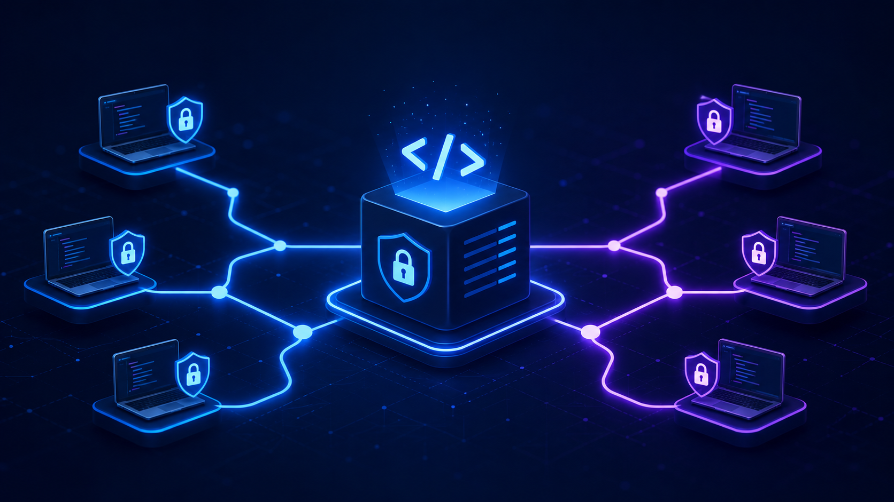
Why shared repos need security controls
A repo is where teamwork happens, but it can also become the easiest place to create risk.
Shared access creates shared risk
The code is also evidence
Security has to be built into the workflow
When several people can push, edit, review, and merge code, one mistake can affect the whole project.
Version history should show who changed what, when it changed, and why it was approved.
The best controls are not extra chores at the end. They are part of how the team branches, reviews, scans, and merges.
My takeaway: the repo should help the team move fast, but not so fast that risky code slips straight into main.
Sources: NIST SSDF SP 800-218; CISA Secure by Design.
Notes:
NIST SSDF says source code and configuration-as-code should be stored in a repository, access should be restricted based on code type, and version control should track changes with individual accountability.

Slide 3
Control #1: limit access and use strong identity
The first control is making sure the right people have the right level of access.
Use least privilege
Protect sign-in
🔐
Not everyone needs admin access. Start with the minimum permissions needed for the role, then add more only when there is a clear reason.
Use strong authentication, especially MFA, for accounts that can change or merge code.
Read
Review access regularly
Keep teams organized
Write
Remove old collaborators, stale service accounts, and unused tokens so forgotten access does not become a back door.
Use groups or teams for permissions instead of handing out one-off access that becomes hard to track.
Admin
Sources: NIST SSDF SP 800-218; CISA Secure by Design.
Notes:
Source controls begin with access control. NIST also emphasizes restricting repository access based on the nature of the code.

Slide 4
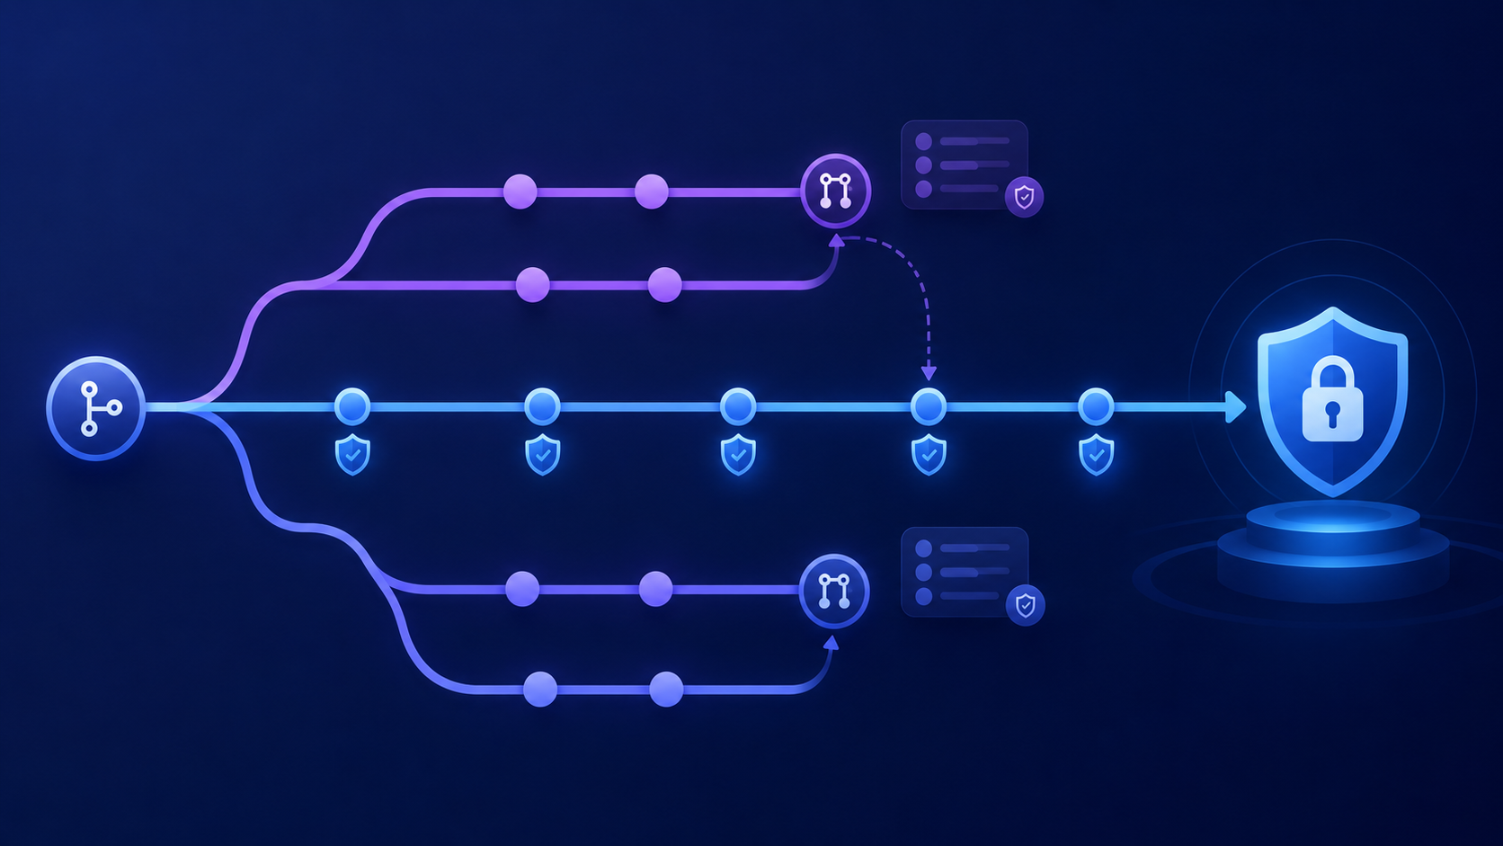
Control #2: protect the main branch
The main branch should be treated like the official version of the project, not a scratch pad.
Require pull requests
Require status checks
Restrict bypasses
Instead of pushing directly into main, changes should come through a pull request where the team can see and discuss them.
Tests, builds, and scans should pass before the merge button is available.
Only a small number of trusted people should be able to bypass rules, and that should be rare.
1
feature branch
2
pull request
3
required checks
4
approved merge
Sources: GitHub Docs, “About protected branches,” “About rulesets,” and “Available rules for rulesets.”
Notes:
GitHub branch protection and rulesets can require pull requests, required checks, signed commits, code owner reviews, and linear history before merge.

Slide 5
Control #3: use reviews and ownership
Pull requests work best when review is part of the team habit, not just a button to click.
Pull Request Review
CODEOWNERS helps route review
Files can have owners so changes are reviewed by the people responsible for that part of the project.
✓ What changed?
✓ Who owns it?
One reviewer is not always enough
Important code, deployment files, and security-sensitive areas may need more than one approval.
✓ Do tests pass?
✓ Any security issue?
Review should be useful
A good review checks logic, readability, tests, security impact, and whether the change matches the assignment or issue.
Sources: GitHub Docs, “About CODEOWNERS,” “About protected branches,” and “Available rules for rulesets.”
Notes:
GitHub documentation explains that CODEOWNERS can be connected to branch protection so code owner approval is required before changes are merged.

Slide 6
Control #4: keep secrets out of code
Passwords, API keys, tokens, and private keys should not be sitting in source files.
Do not commit:
Use environment variables or secret stores
Turn on secret scanning
Real credentials should live outside the repo. The code can read them at runtime without exposing them in commits.
Secret scanning helps find credentials that are already in the repository history.
✕ database passwords
✕ personal access tokens
✕ private keys
Use push protection
Rotate exposed secrets
Push protection can block a secret before it ever lands in the repository.
If a secret is committed, deleting the line is not enough. Rotate or revoke it.
✕ .env files with real values
Sources: GitHub Docs, “Secret scanning” and “Push protection.”
Notes:
GitHub says secret scanning checks repository history for hardcoded credentials, while push protection blocks supported secrets before they are pushed.

Slide 7
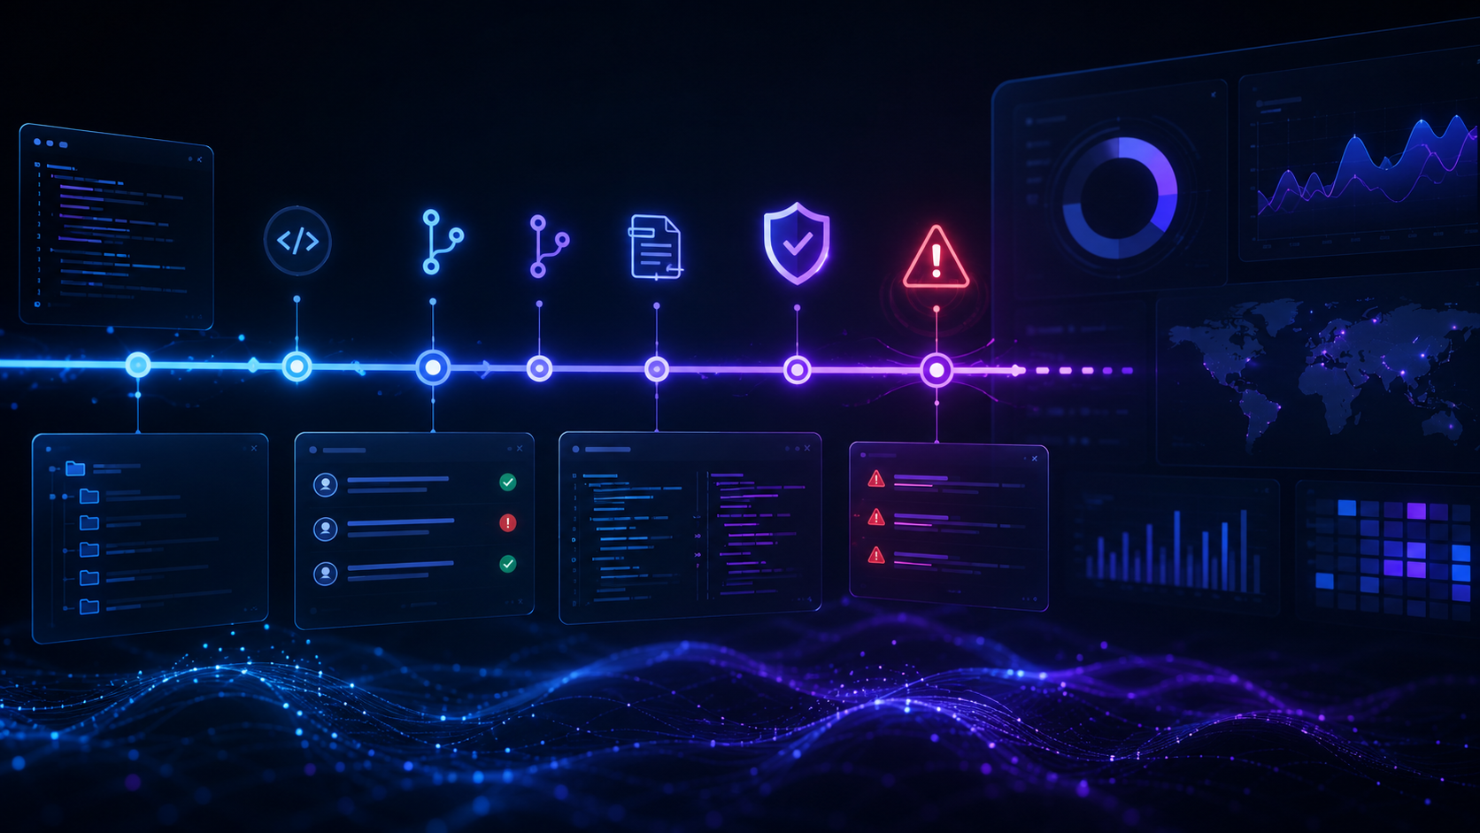
Control #5: scan code and dependencies early
Security scans are better when they catch problems before the code is merged.
Static/code scanning
Dependency updates
Security checks in the pull request
Code scanning looks for security problems and coding mistakes in the repository so they can be fixed earlier.
Dependency tools can warn the team when a library has a known vulnerability and can open update pull requests.
When scans run in the PR, the team can fix issues before they become part of main.
1
commit
2
build
3
test
4
scan
5
review
6
merge
Sources: GitHub Docs, “Code scanning” and “Dependabot security updates.”
Notes:
GitHub describes code scanning as a way to analyze repository code for security vulnerabilities and coding errors. Dependabot security updates can raise pull requests to fix vulnerable dependencies.

Slide 8
Control #6: protect integrity and traceability
A secure repo should make changes easy to trace and harder to fake.
✓
✓
✓
✓
✓
signed commits
named accounts
clear messages
linked issues
auditable merges
Use commit signing when needed
Avoid shared accounts
Make history explain the work
Signed commits help prove that a commit came from a trusted identity instead of someone pretending to be that person.
If five people use one account, the history stops being useful. Every person should commit under their own identity.
Good commit messages, pull request descriptions, and linked issues make future troubleshooting easier.
Sources: NIST SSDF SP 800-218; GitHub Docs, “About rulesets.”
Notes:
NIST SSDF specifically lists using version control for accountability and using commit signing as examples of protecting source code. GitHub rulesets can also require signed commits.

Slide 9
Control #7: monitor, audit, and respond
Security controls still need follow-up, because settings and people change over time.
Watch security alerts
Review logs and permissions
Have a response plan
Code scanning, secret scanning, and dependency alerts should be reviewed instead of ignored.
The team should know who changed settings, who merged to main, and who still has access.
If a secret leaks or a bad change gets merged, the team should know how to revoke, revert, notify, and document it.
My basic incident loop
1
Detect
2
Contain
3
Fix
4
Review
Sources: GitHub Docs, “GitHub security features”; CISA Secure by Design.
Notes:
The point here is that repo security is not just settings. Someone has to review alerts, maintain ownership, and respond when something goes wrong.

Slide 10
Quick checklist and sources
The goal is simple: protect the code without blocking teamwork.
My security checklist
Sources
✓ Use least privilege and MFA
• NIST SP 800-218, Secure Software Development Framework (SSDF), Version 1.1 https://csrc.nist.gov/pubs/sp/800/218/final
✓ Protect main with rulesets
• CISA, Secure by Design guidance https://www.cisa.gov/securebydesign
✓ Require pull requests and reviews
✓ Use CODEOWNERS for sensitive areas
• GitHub Docs: protected branches, rulesets, and CODEOWNERS https://docs.github.com/en/repositories/configuring-branches-and-merges-in-your-repository/managing-protected-branches/managing-a-branch-protection-rule
✓ Block secrets before they are pushed
• GitHub Docs: secret scanning and push protection https://docs.github.com/en/code-security/concepts/secret-security/push-protection
✓ Scan code and dependencies
✓ Use clear history and signed commits
• GitHub Docs: code scanning and Dependabot security updates https://docs.github.com/en/code-security/concepts/supply-chain-security/dependabot-security-updates
✓ Review alerts, access, and logs
Repository URL: https://github.com/Panda-Alex21687/CSD380
Full web citations were researched from official NIST, CISA, and GitHub documentation.

